Slide 1
527 Data Analytics
April 26, 2016
Final Project, Group 11

Slide 2
Agenda
Introduction
Company Background
Analysis Approach
Findings
Corpus Analysis – Term Document Matrix
Conclusion

Slide 3
Introduction
Team-Group 11
Eugenio Moreno
Jessica Ginesta
Cristina Quiroga
Dinesh Kawatia
Suryanarayana Tadimety V N B
Objectives
Analyze available DEF 14A form of a Company over a period of time
Identify trends w.r.t CEO Salary, Stock Trading Activity changes, before and after filing
Identify trend in Q & A Term Document Matrix Statistics
Input For Analysis
Form DEF 14A- A mandatory filing with the Securities and Exchange Commission (SEC) by or on behalf of a registrant when a shareholder vote is required. It is most commonly used in conjunction with an annual meeting proxy
R-Tools –For Data extraction,cleansing,analysis
Excel-Analysis and Reporting
Historical Stock price data of the company
Notes:
DEF 14A includes information about the date, time and place of the meeting of security holders; revocability of proxy; dissenter's right of appraisal; persons making the solicitation; direct or indirect interest of certain persons in matters to be acted upon; modification or exchange of securities; financial statements; voting procedures; and other details.

Slide 4


Company Background
Company -Exelon Corporation
America's Leading Energy Group of electric generation and electric and gas delivery companies
Exelon Corporation family of companies(FOC) represents every stage of the energy value chain as represented in the picture below
In the year 2000 companies Unicom and PECO came together to form Exelon Corporation
FOC-Exelon Electric Generation
FOC-Constellation
FOC-BGE, ComEd, PECO
Number 1 utility company on the FORTUNE 500 (#119 –Overall rank)
America's #1 zero-carbon nuclear energy provider
Business in 48 states in US and Canada
Revenues of $34.5 billion in the year 2015
32,700 MW of total owned power generated by Exelon in 2015
10 million Exelon electric and natural gas customers served by the six​​ utilities
Employ approximately 34,000 associates
Notes:
DEF 14A includes information about the date, time and place of the meeting of security holders; revocability of proxy; dissenter's right of appraisal; persons making the solicitation; direct or indirect interest of certain persons in matters to be acted upon; modification or exchange of securities; financial statements; voting procedures; and other details.

Slide 5
Analysis Approach
Download DEF 14 forms of Exelon Corporation from https://www.sec.gov/ and used that as an input in R code
Years considered for analysis – 2000 to 2016 (There is no DEF 14 form in 2005)
Developed R code to read the Summary Compensation table from the DEF filing report and export the data to a “.csv” file
Developed R code to read Q & A section and create a Term Document Matrix (TDM)
Analyze the trend of the CEO Salary, Option Awards, and Stock Awards in excel file
Find stock trading activity changes before and after 10 days from the date of DEF filing(source - http://finance.yahoo.com)
Analyze Q&A Term Document Matrix : patterns and tendencies
Identify KEIs
Conclusions

Slide 6
Findings-Change in CEO
Key date: 19/03/2009 (publication of the DEF 14)
CEO Name | First year as a CEO | Last Year as a CEO | Previous position
Christopher M. Crane | 2009 | Current | Chief Operating Officer at Excelon
John W. Rowe | 2000 | 2009 | CEO of UnumProvident Corporation
Notes:
UnumProvident Corporation: Insurance company

Slide 7
Findings-CEO Salary Trend
New CEO has lower salary than the previous one, due to his lack of experience within this position in Excelon

Slide 8
Findings –Stock Price Trend
In 2009, due to the expectation and uncertainty of the election of a new CEO, the stock price fell in the days before to the publication
The following days the price rose again as a reflection of the stakeholders' trust in the new CEO.

Slide 9
Findings –Stock Price Trend II
Even though Exelon is an electric company with a low volatility (β) the global financial crisis of 2008 reverberated in the stock price
Stock price fell in 2008 and it had a 45% less value when the filing was published in 2009.

Slide 10
Findings -Other trends
When the CEO has a lower base salary he received higher number of option awards
M&A
Merge with Public Service Enterprise Group Inc (2005)
Merge with Constellation Energy (2012)
Increase of the equity value

Slide 11
Corpus Analysis- Exelon Number of Words
Year | Total Words
2016 | 330
2015 | 330
2014 | 330
2013 | 326
2012 | 326
2011 | 307
2010 | 198
2009 | 198
2008 | 198
2007 | 250
2006 | 450
2004 | 276
2003 | 330
2002 | 361
2001 | 429
The range of words between all the fillings is of 231.
The highest number of words are found in 2001 (429 words) and the least in 2009-2010 (198 words).

Slide 12
Corpus Analysis- Exelon KEI
Proxy Activity Statement KEI
Words | Frequency
Vote | 794
Proxi | 632
Meet | 516
Annual | 439
Director | 271
Share | 256
Record | 236
Exelon | 232
Corpor | 211
Receiv | 209
The most common words are “vote” and “proxy” because most of the Q&A are related to how to vote or designate a proxy

Slide 13
Corpus Analysis- Exelon KEI
There is a much higher number of appearances in 2013 of the word vote because the main purpose of the frequently asked questions was to specify the procedure on how to vote including questions such as:
Who is entitled to vote at the annual meeting?
How do I vote?

Slide 14
Corpus Analysis- Exelon KEI
Exceptional KEI
Words | Frequency
Central | 1
Power | 1
Discretionary | 1
Toward | 1
Accordingly | 1
Chase | 1
Announcements | 1
Combine | 1
Detach | 1
Retirement | 1
Since the frequently asked questions are related to the procedure on how to vote, there is no need to use these words. Thus, they randomly appear in just one of the files.

Slide 15
Corpus Analysis- Exelon Context of less frequent words
Word in the document | Word | Year | Sentence
Central | Central | 2006 | The annual meeting will be held on Tuesday, June 27, 2006 at 9:30 AM, Central Daylight Savings Time, at the Chase Tower Auditorium, 10 South Dearborn Street, Chicago, Illinois.
Power | Power | 2001 | Chairman of the Board of Trustees of the Institute for Defense Analyses, and a member of the Advisory Council for the Institute of Nuclear Power Operations.
Discretionary | Discretionar | 2001 | The Unicom shares were acquired for Mr. Brennan by a broker having the discretionary authority to do so under a standing brokerage account. Mr.Brennan was not aware of the share acquisition, and did not file a timely report. Mr. Brennan became aware of the acquisition after the shares were sold in January 2001, and that sale was timely reported.
Toward | Toward | 2006 | Exelon will make announcements about the status of progress toward completion of the merger as significant developments occur.
Accordingly | Accord | 2001 | Mr. McNeill, Mr. Egan, and Mr. McLean were not officers of Unicom Corporation, and were accordingly not eligible for awards under this plan.

Slide 16
Corpus Analysis- Exelon Context of less frequent words
Word in the document | Word | Year | Sentence
Announcements | Announc | 2006 | Exelon will make announcements about the status of progress toward completion of the merger as significant developments occur.
Combine | Combin | 2006 | Exelon and PSEG have completed all significant merger integration planning tasks needed to combine the operations of Exelon and PSEG after the merger is approved.
Detach | Detach | 2003 | Admittance to the annual meeting is limited to shareholders who are eligible to vote or their authorized representatives. If you wish to attend the meeting, detach and bring the bottom half of your proxy which is marked as your “Admission Ticket.” Also, be sure to bring a photo ID.
Retirement | Retir | 2003 | Proposal 3: Consideration of a shareholder proposal to urge the Board to seek shareholder approval of any extraordinary pension benefits for senior executives under the Company’s supplemental executive retirement plan (the “SERP”).
Chase | Chase | 2006 | The annual meeting will be held on Tuesday, June 27, 2006 at 9:30 AM, Central Daylight Savings Time, at the Chase Tower Auditorium, 10 South Dearborn Street, Chicago, Illinois.

Slide 17
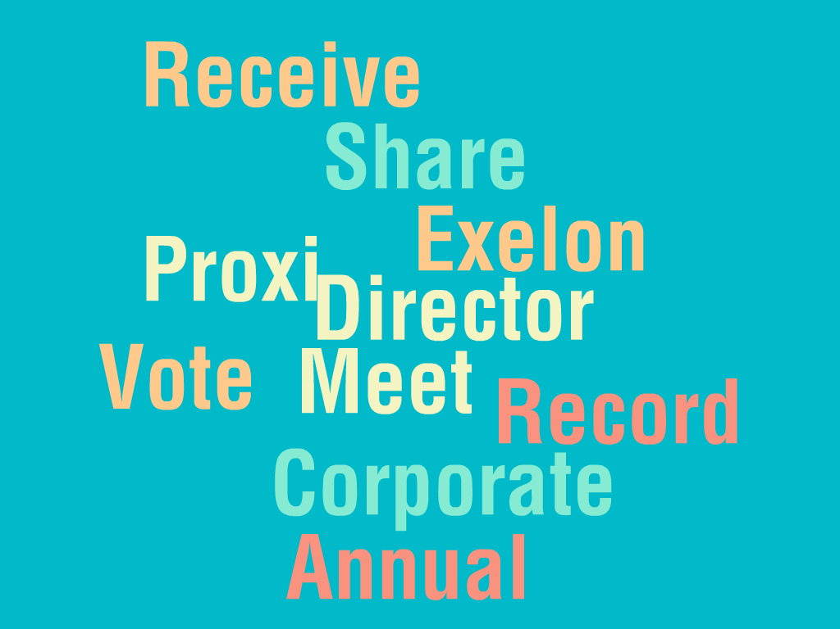
Corpus Analysis- Exelon Word Cloud
Proxy Activity Statement KEI

Slide 18
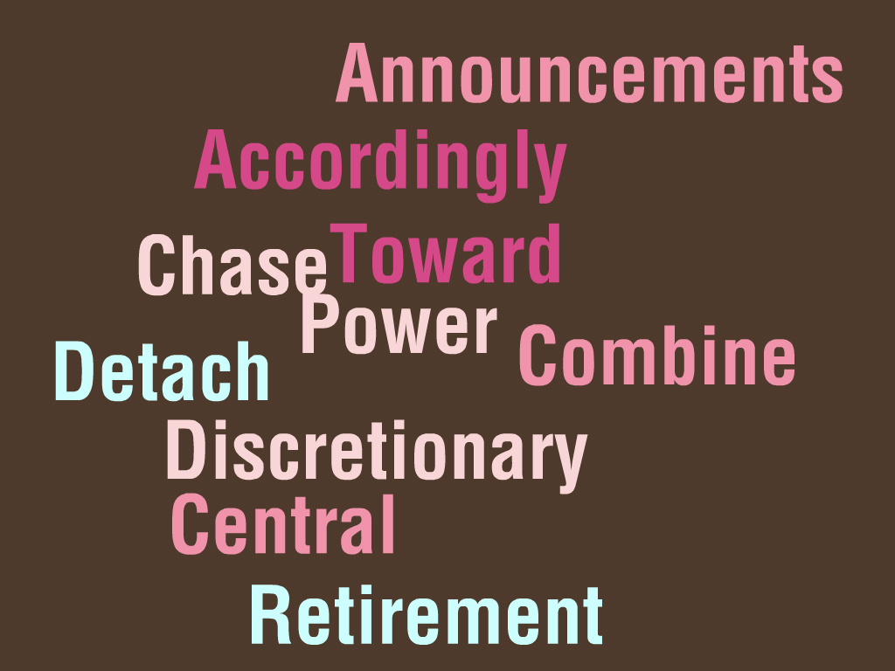
Corpus Analysis-Exelon Word Cloud
Exceptional KEI

Slide 19
Conclusions
In 2009, there was a fluctuation of stock price due to change of guard to a new CEO, which again restored to normal after the appointment.
The most frequent words are meet, vote, annual, director. These words describe the main purpose of the DEF 14A form.
Some less frequent words such as retirement and combine are due to certain events happening at Exelon which were a new retirement plan which was announced in 2003 and the merger with the company with PSG in 2006.
Analyzing the Q&A from 2001-2016 it has been determined that this section has a very similar content and same format.

